Slide 1
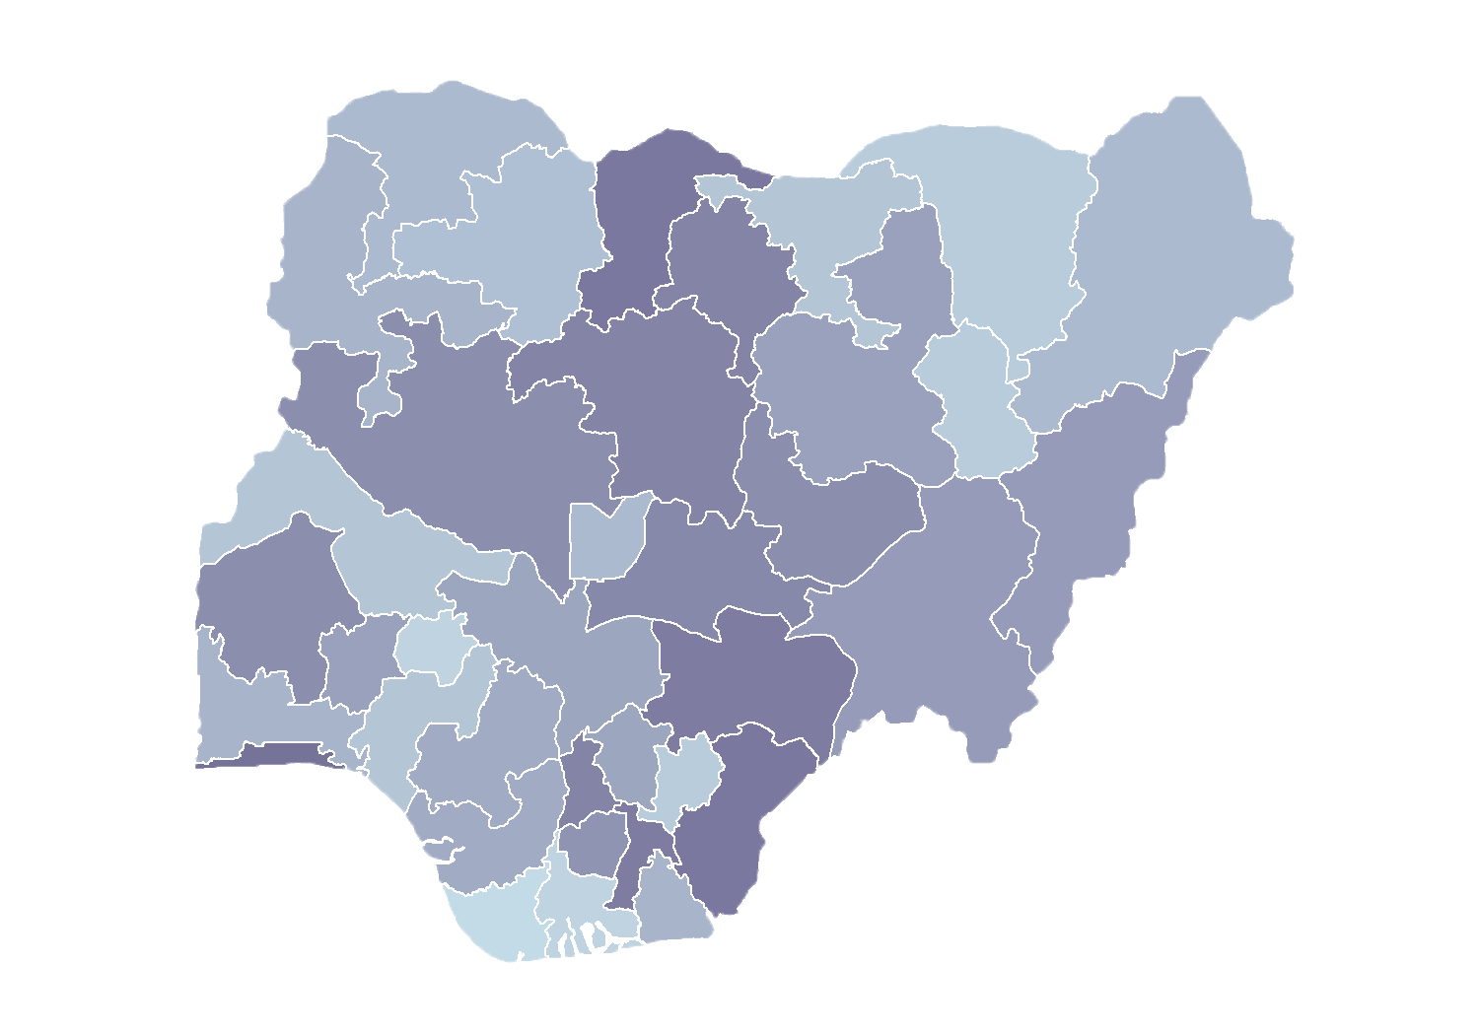
Module 1.2
Value of the Master Facility List
Rollout of Health Facility Registry/Master Facility List for States and Local Government Areas in Nigeria
March 2019

Slide 2
Outline
Introduction
Why invest in a master facility list (MFL)?
Visualize distribution of health facilities
Future perspectives
Discussion

Slide 3
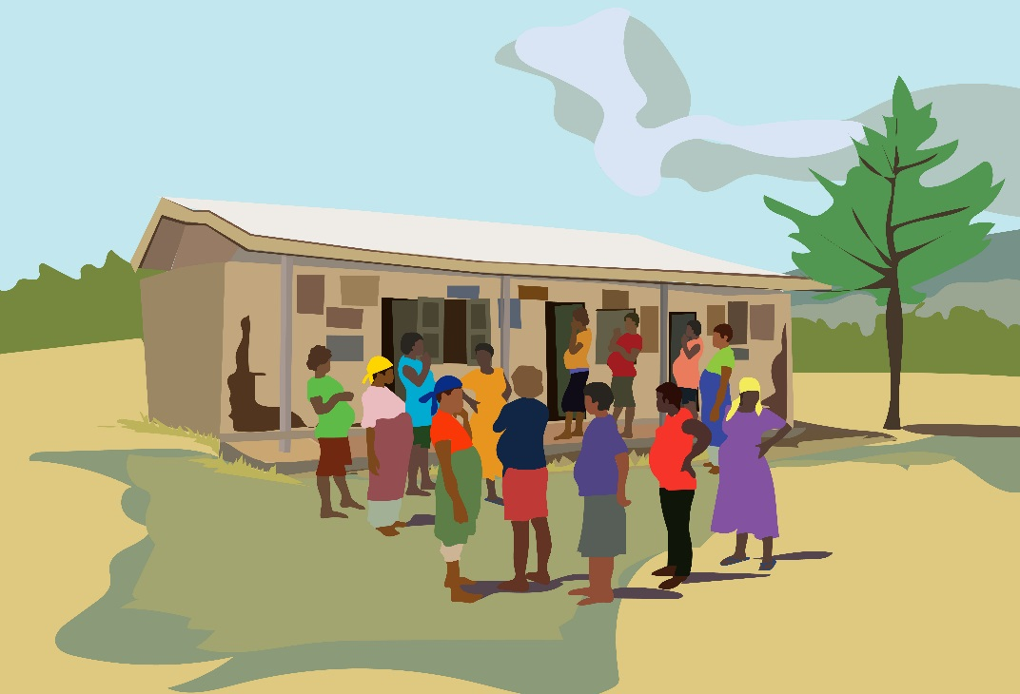
Introduction

Slide 4
Nigeria MFL
This MFL is the result of harmonizing distinct lists into a single list.
It is expected to have complete data for each health facility, including signature and service domains.
Data are also expected to be of high quality (duly verified by appropriate officials) and to include accurate geocoordinates.
The MFL is updated regularly and stored in the Health Facility Registry (HFR).

Slide 5
Who needs an MFL?
Stakeholders
Facility lists are used by a range of stakeholders:
Government for budgeting and allocation of health resources
Backbone for interoperability with other health management information systems (HMIS)
Disease surveillance
Human resource management
Supply chain management
Insurance companies
Donors planning coverage for interventions
Researchers assessing heath system performance

Slide 6
What happens when
an MFL is lacking?
Updates are made to the facility list; the new (slightly different) facility list is often re-shared!
Updates to the facility name, services offered, or operational status are collected directly from the health facilities.
I know! I’ll call my friend, he owes me a favor!
I need to set up this Excel tracker quickly!
These facility lists serve as the basis for a range of information systems.
When an MFL is not available, facility lists are often shared by e-mail.
Multiple facility lists with inconsistent data!
Notes:
Oftentimes, when an online MFL is not available, a facility list is sent electronically (by e-mail)
Subsequently, stakeholders use this list to create their own information systems Oftentimes, those close to the ground get updates directly from the facility (name change, increase in services, shift in status to receive subsidized medications, etc.)
The list is re-shared as it is difficult to control who receives the list
Lack of multiple facility lists reporting on the same interactions (supply management, human resources, service delivery, disease surveillance)
Governance, as facilities are updated without appropriate approvals

Slide 7
Why invest in a
master facility list?

Slide 8
Integrated approach
for effective management
An MFL allows effective use of resources to maintain and update a single list, rather than duplicative efforts by various stakeholders to maintain separate lists.
Pooling or focusing resources to maintain a single list can lead to better-quality facility data.
Data are updated and validated more frequently.

Slide 9
Improved health facility
planning and management
An MFL that contains geocoordinates for health facilities provides the means of knowing:
What health services are available
Whether health services are distributed equitably
Where new health facilities are needed
Notes:
An MFL provides the metadata needed by other information systems.
The MFL contains information about facilities that is needed by the HMIS and other information systems to categorize facilities within these systems. For example, facility location information (such as region, district, and ward data) is used in the HMIS to create organizational unit hierarchies. Information about facility ownership can be used in health worker registries to identify which facilities are staffed with government or private sector employees.

Slide 10
Other potential uses of MFL
Strengthens provider referrals to specialized facilities
Allows the general public to access a list of facilities when seeking care
During natural disasters or disease outbreaks, lets first responders know where health facilities are located and what services are available
Notes:
The uses of the MFL listed here can occur even before MFL is integrated with other health information systems.
An MFL that contains information about services can help providers identify the most appropriate health facilities for referring clients.
If accessible to the general public, the MFL allows potential clients to identify where to seek the services they need.
In emergency situations involving natural disasters or disease outbreaks, an MFL helps responders know where health facilities are located and what services are available.
An MFL serves as a comprehensive sampling frame for researchers or institutions that want to conduct a health facility survey or census.

Slide 11
Other potential uses of MFL
Provides researchers a sampling frame for health facility surveys
Makes it possible to visualize facility distribution; for example:
Proximity of health facilities
Private vs. public facilities
Notes:
The uses of the MFL listed here can occur even before MFL is integrated with other health information systems.
An MFL that contains information about services can help providers identify the most appropriate health facilities for referring clients.
If accessible to the general public, the MFL allows potential clients to identify where to seek the services they need.
In emergency situations involving natural disasters or disease outbreaks, an MFL helps responders know where health facilities are located and what services are available.
An MFL serves as a comprehensive sampling frame for researchers or institutions that want to conduct a health facility survey or census.

Slide 12
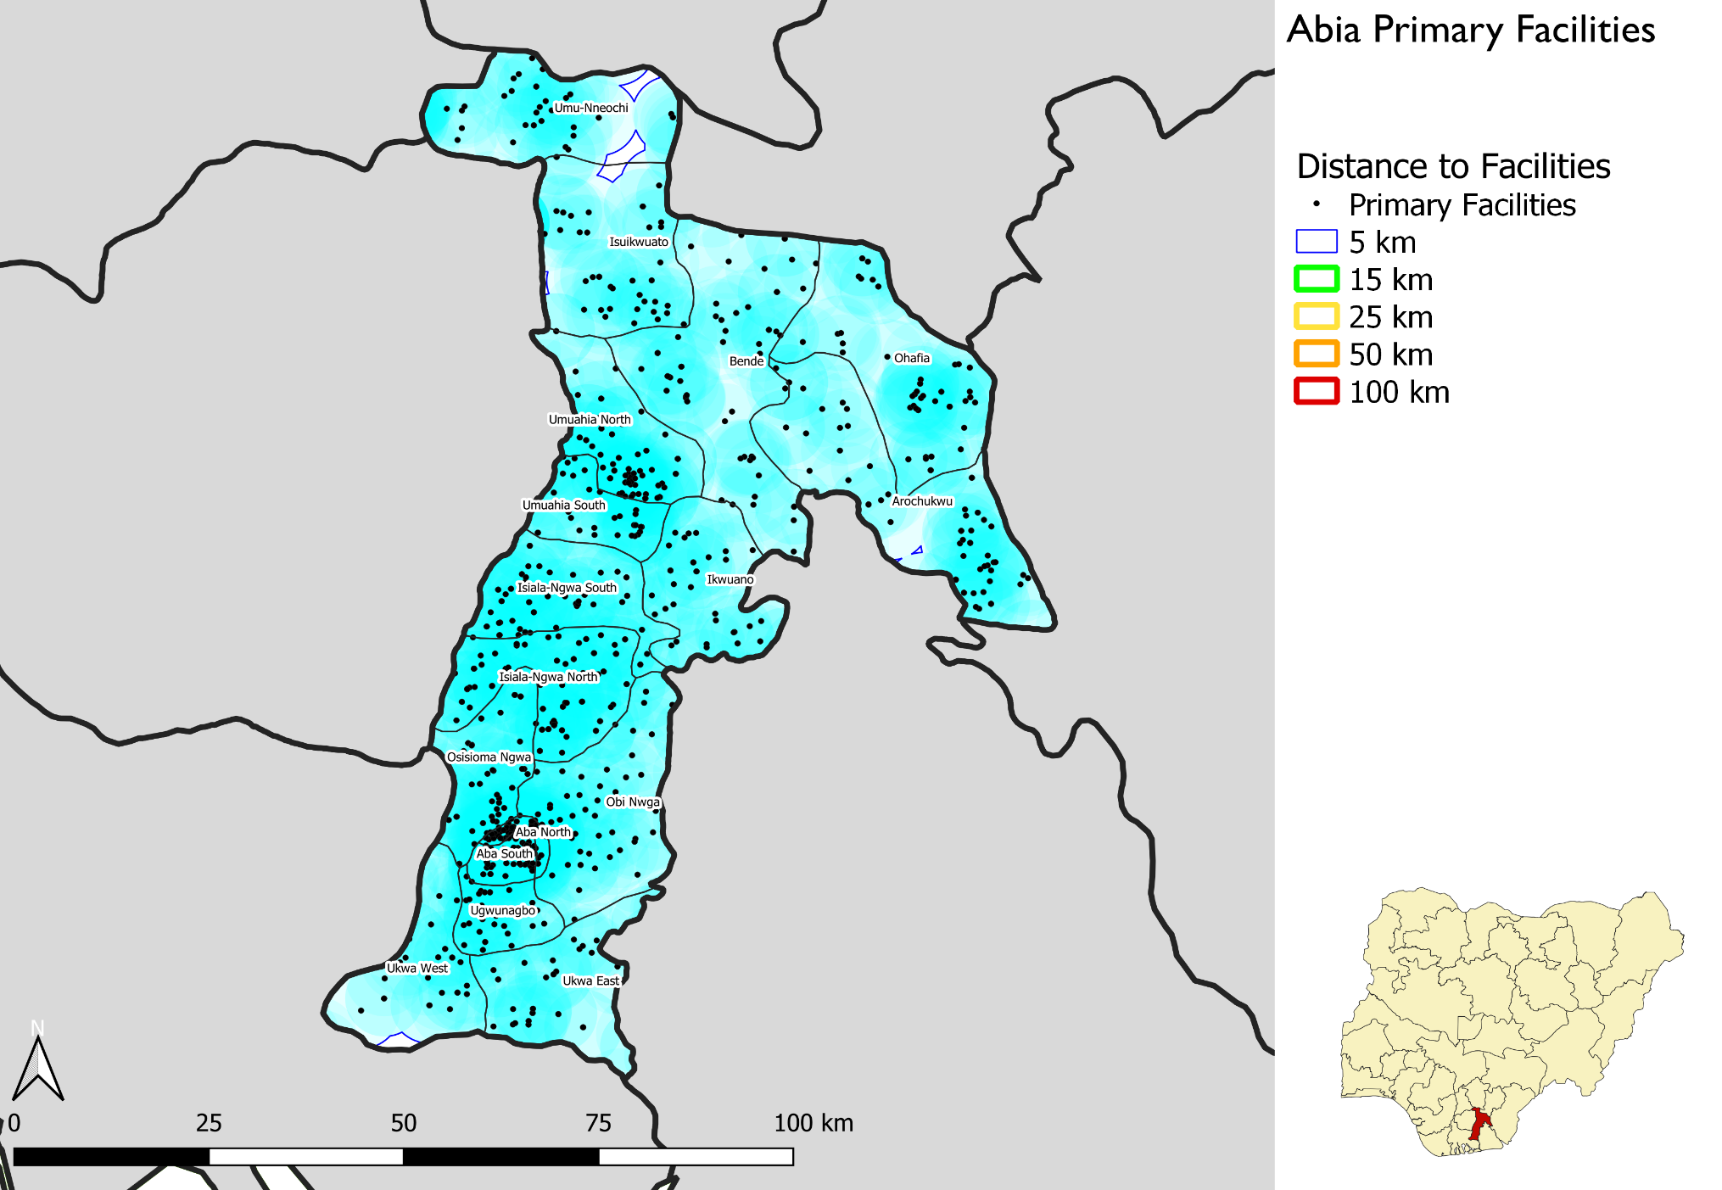
Proximity of primary
health facilities in Abia
Notes:
Map shows the distance of communities from primary health facilities
Most of the communities are not more than 5 km away from primary heath facilities
No community is more than 15 km away from a primary facility

Slide 13
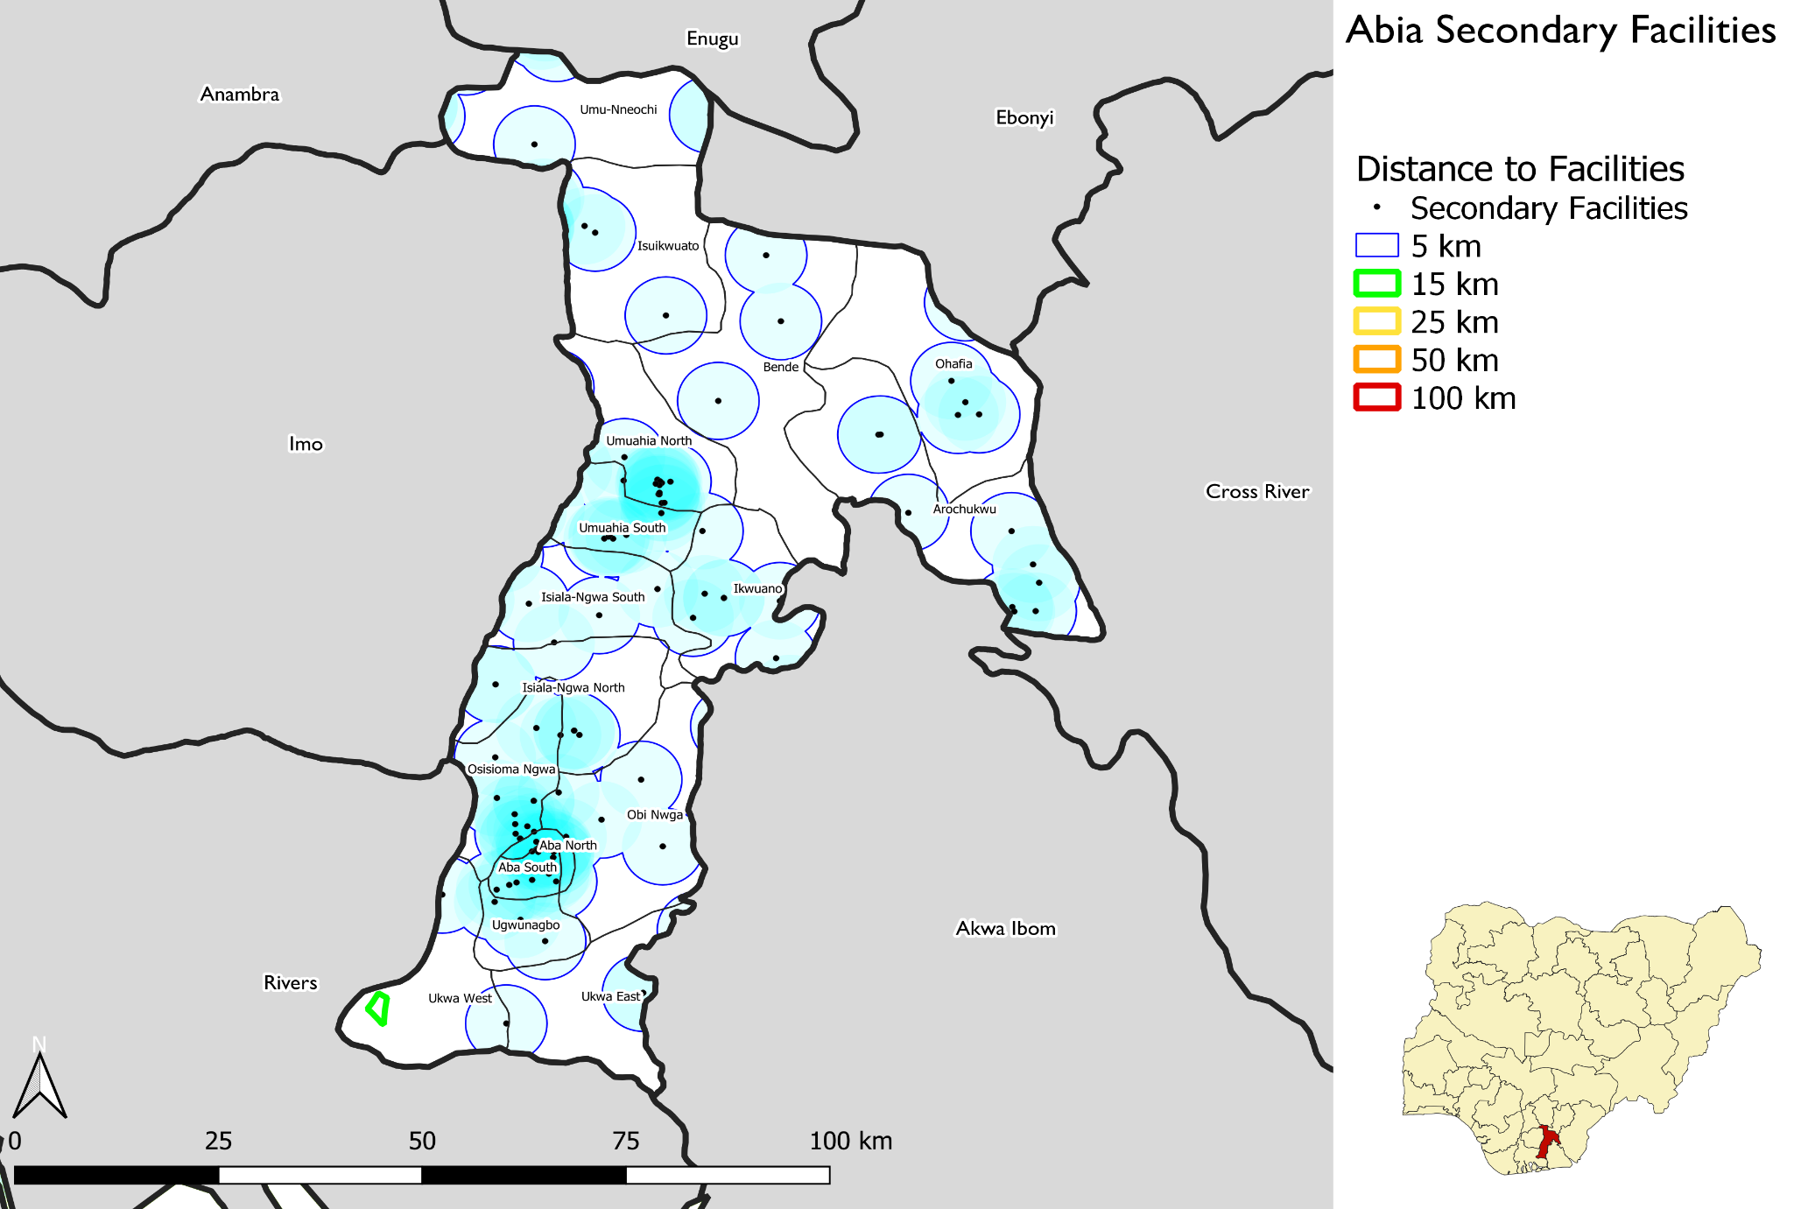
Proximity of secondary
health facilities
Notes:
Map shows the distance of communities from secondary health facilities
Few communities are more than 5 km away from secondary facilities
No community is more than 25 km away from a secondary facility

Slide 14
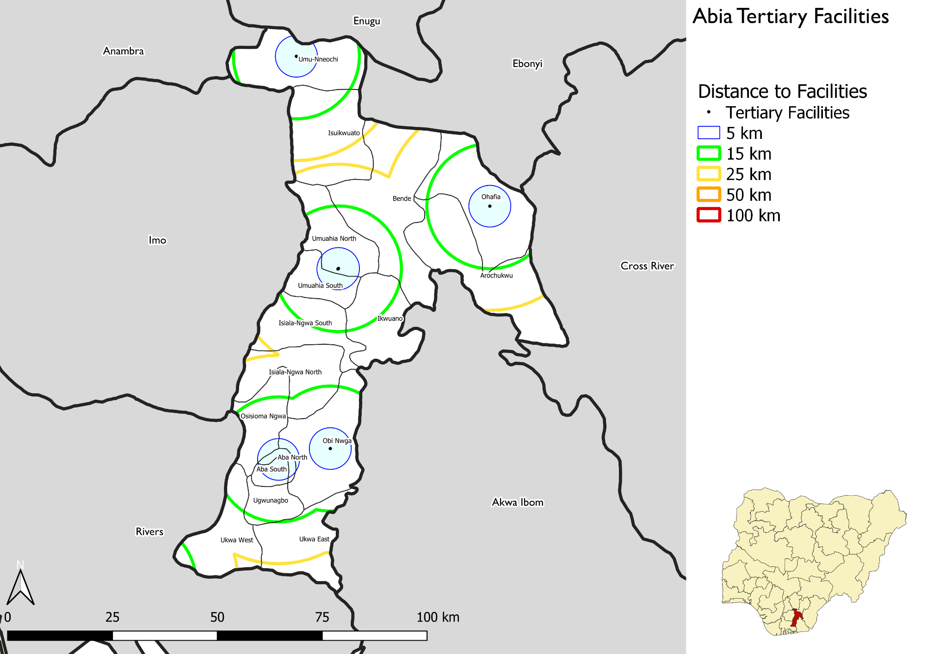
Proximity of tertiary
health facilities
Notes:
Map shows the distance of communities from tertiary health facilities
We can see few communities are more than 5 km from tertiary heath facilities

Slide 15
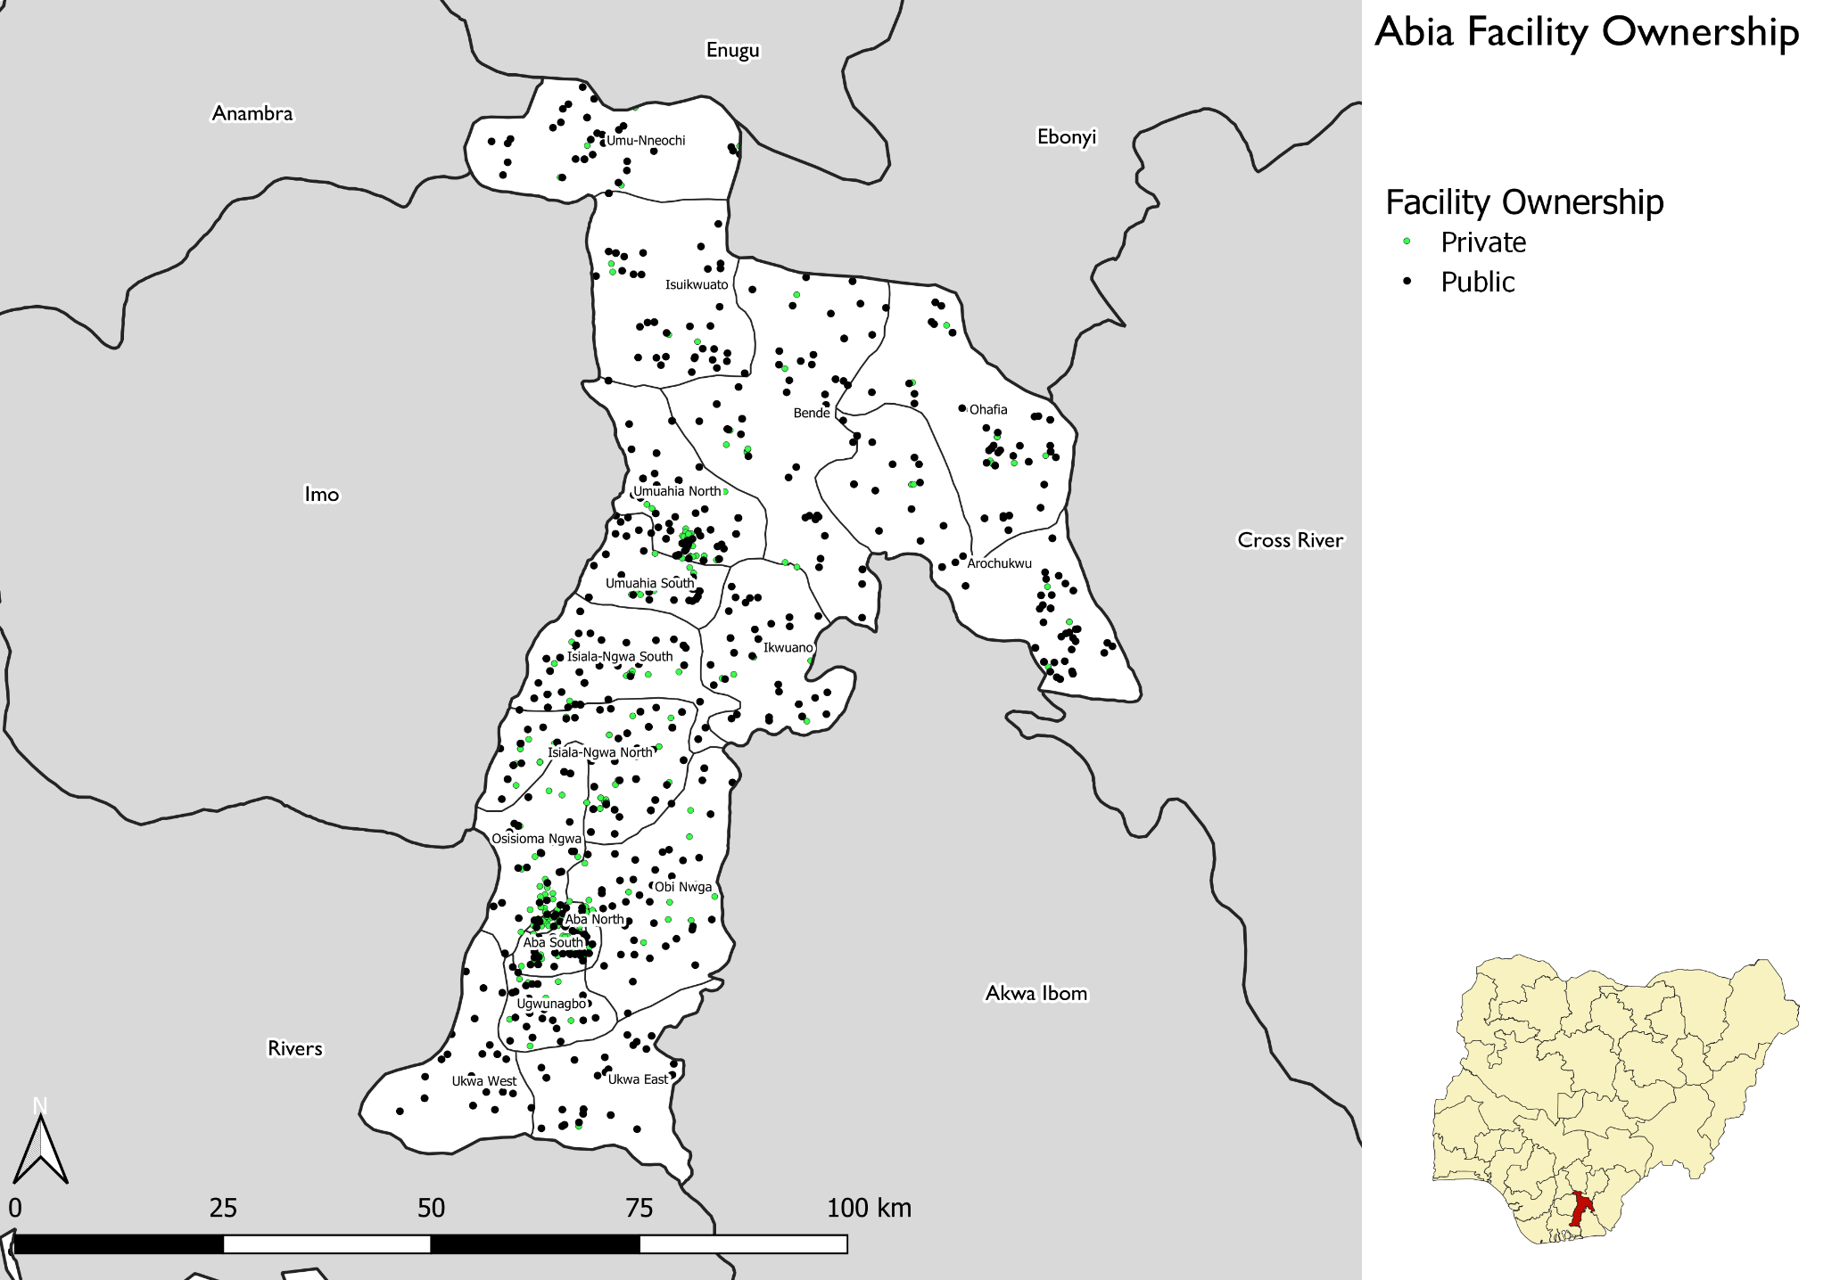
Distribution of
public facilities vs. private facilities
Notes:
Map shows the distribution of health facilities of public and private facilities
Green dots represent private facilities
Black dots represent public facilities

Slide 16
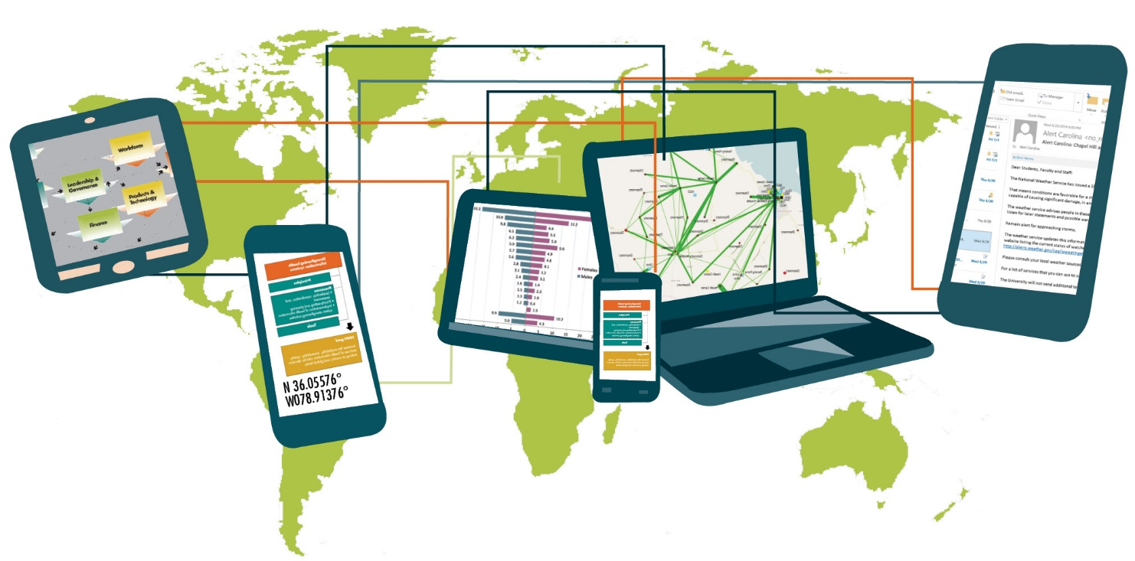
Future perspectives

Slide 17
Integration of the district
health information software (DHIS 2) and HFR
The MFL technical working group identified the DHIS 2 as the priority system for integration.
Successful integration with DHIS 2 may lead to integration with other health information systems.
In an automated process, the DHIS 2 will check for discrepancies and then harmonize with the content of the MFL.
Once the systems are linked, updates to the facility list will occur within the HFR and be shared with the DHIS 2.

Slide 18
Discussion

